Slide 1
DITA Maps

Slide 2
Session results
DITA Map Definition and Purpose
Power of DITA Maps
DITA Map Types
Bookmaps – Additional Information
DITA Maps Practice
DITA Maps Examples
Under the DITA Map Hood
DITA Maps Best Practices
DITA Sub-map Uses

Slide 3
DITA map definition and purpose
DITA Maps Definition
Glue that binds your topics together – More powerful than a table of contents or a FrameMaker book file
DITA maps are the basis for navigation and linking content together
DITA Maps Purpose
Determine which topics show up in your output
Define the navigation for a set of topics in a work flow to meet user needs
Create relationships between topics – Relationship (Rel) tables for Help/HTML output (We will not cover today.)
Note: DITA maps have a .ditamap file extension.

Slide 4
Power of DITA maps
Power
DITA maps can be combined together in a master DITA map
DITA maps can be nested within other DITA maps
Non-DITA content can be referenced in a DITA map
End Result
Endless combinations of topics to create different outputs relatively quickly and easily (Most of us can’t do this today.)
Examples
Product Suite – Support wanted an online reference of the entire documentation set. Created a master DITA map and referenced 10 other DITA maps. Published web help to a support site.
Best Practices – Customer wanted a document with all of our best practices. Created a DITA map, added best practice topics, and generated PDF.
Training Workbook – Customer wanted a PDF of the training materials for three-day training. Created a master DITA map, referenced training materials, and generated a PDF.

Slide 5
DITA Map Types
Traditional DITA map – Used for all types output
Bookmap – Designed specifically for traditional book-like information (DITA tags and attributes are specific for books)

Slide 6
Bookmaps – Additional information – Tech alert!
Special type of a DITA map that was introduced with DITA 1.1. Create a hierarchy of topic references that resembles the structure of a printed book. The general order of elements in a bookmap is similar to that of the map, although the top-level map element names will be different. The title of a bookmap can be bookmap/title or bookmap/booktitle. The bookmap’s metadata is stored in the bookmeta element (very similar to the topicmeta of the map).
The most significant difference between the map and bookmap are the topic referencing elements. A bookmap provides many specialized topic referencing elements for book-specific purposes that group topicrefs into logical sections.
The first logical grouping is the frontmatter element. The frontmatter element can contain a number of topic referencing elements (including topicref) that specify topics that are part of a book’s frontmatter. A similar backmatter element can be added at the end of the book. One of the special elements in the frontmatter and backmatter is the booklists element.
The booklists element (a child of the frontmatter and backmatter elements) can contain one or more “list” elements that are intended to provide generated lists (similar to the FrameMaker generated list files like a “toc” or “index”).
Following the frontmatter element can be a number of topic grouping elements such as part, chapter, and appendix. The part element can be used to organize chapter and appendix elements into parts, and the chapter and appendix elements are used to organize topicrefs. After the last part, chapter, or appendix can be the backmatter element, similar to the frontmatter element described above.
A bookmap can also make use of relationship tables in the same way they are used in a map. Even though your bookmap may make use of part, chapter, and appendix topic referencing elements, the reltable can only contain topicref elements.
Bottom Line – Bookmaps give you different DITA tags and attributes that are specifically used for book elements

Slide 7
Let’s Practice DITA Maps
Goals – List the goals we have when you use some piece of software (in the example, we are using Oracle) (keep it to 3 goals)
List the tasks for the goals
List the concepts for the goals
List the reference information for the goals

Slide 8
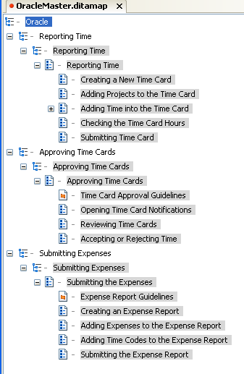
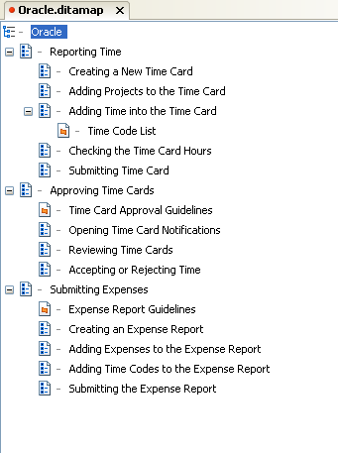
DITA Map Result – Using Oracle
This is what the team built with our three goals
Example 1 has 3 sub-maps and 1 master DITA map
Example 2 has all topics in 1 DITA Map

Slide 9
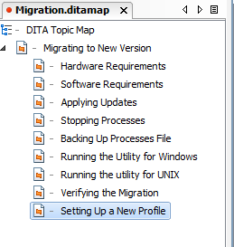
Another example
DITA map organization for this process
You can reuse the hardware and software topics anywhere you would like

Slide 10
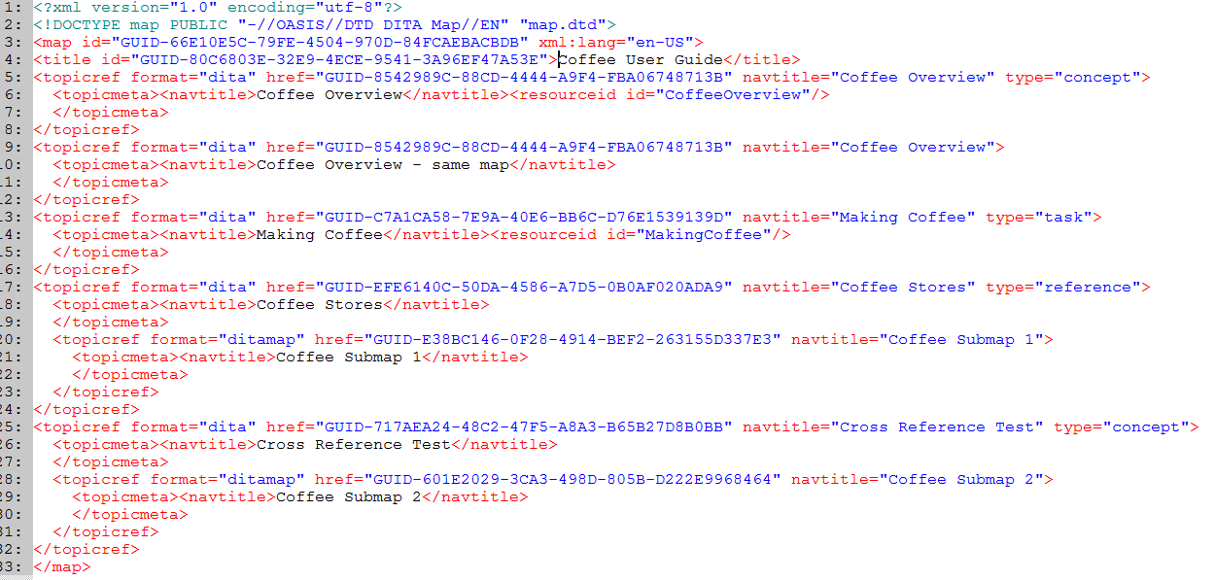
Looking Under the Hood of DITA maps
DITA Map that references other DITA Maps

Slide 11
DITA Map best practices
Avoid nesting topics more than six levels deep – Six levels is pushing it
Add topics to map files so the flow of information best suits users
Only topics in the DITA map are included in the output. References in topics to other topics that are not part of the DITA map are not in the output. The link is removed by default.
Sub-maps – Rather than creating very large DITA map for your content, use sub-maps to break up your content so that it is more manageable

Slide 12
Using Sub-maps
When could you use a sub-map?
Organizing content by chapters
Better manage large information sets (500 topics in a DITA map does not make content management easy)
Reuse sets of topics – If two user guides reuse the same set of topics, create one map and reuse it
Support peer writers working on the same information set – One writer works on one DITA map and the other writer works on another DITA map
Segregate frequently updated content so it can be updated quicker

Slide 13
Session Results – Where we’ve been
DITA Map Definition and Purpose
Power of DITA Maps
DITA Map Types
Bookmaps – Additional Information
DITA Maps Practice
DITA Maps Examples
Under the DITA Map Hood
DITA Maps Best Practices
DITA Sub-map Uses

Slide 14
Start thinking
When working on projects:
Start thinking about content organization using DITA maps
If you have time, think through a DITA map structure for a document you own

